Slide 1
Lightning Talk
Aligning Architecture With Strategy

Slide 2
What About Architecture?
?
Framework
?
Tradeoffs
?
Context
!
Strategy

Slide 3
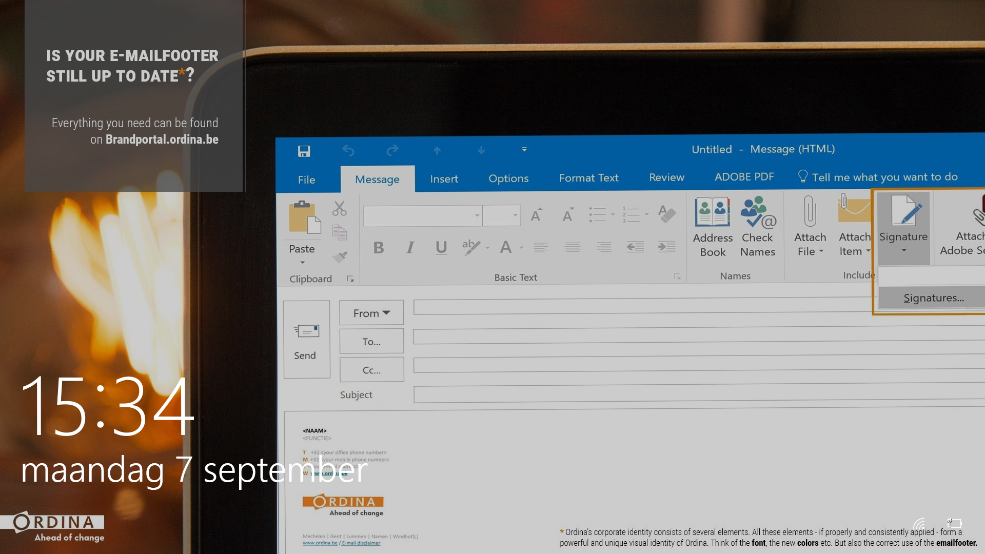
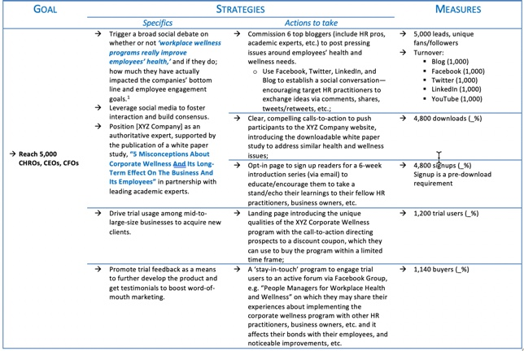
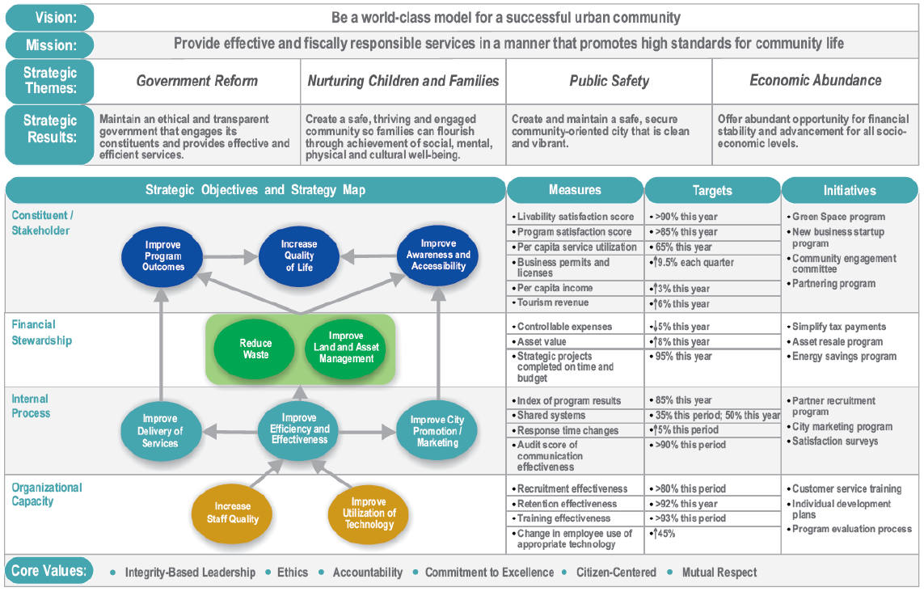
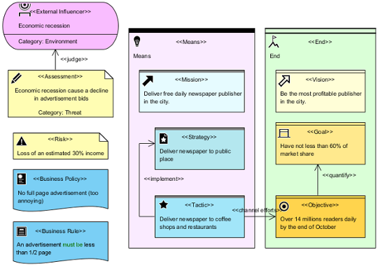
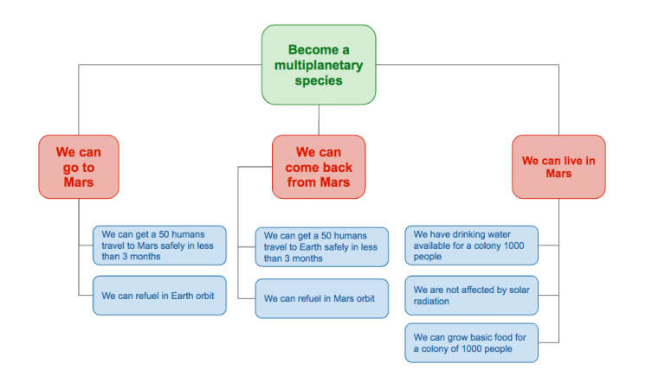
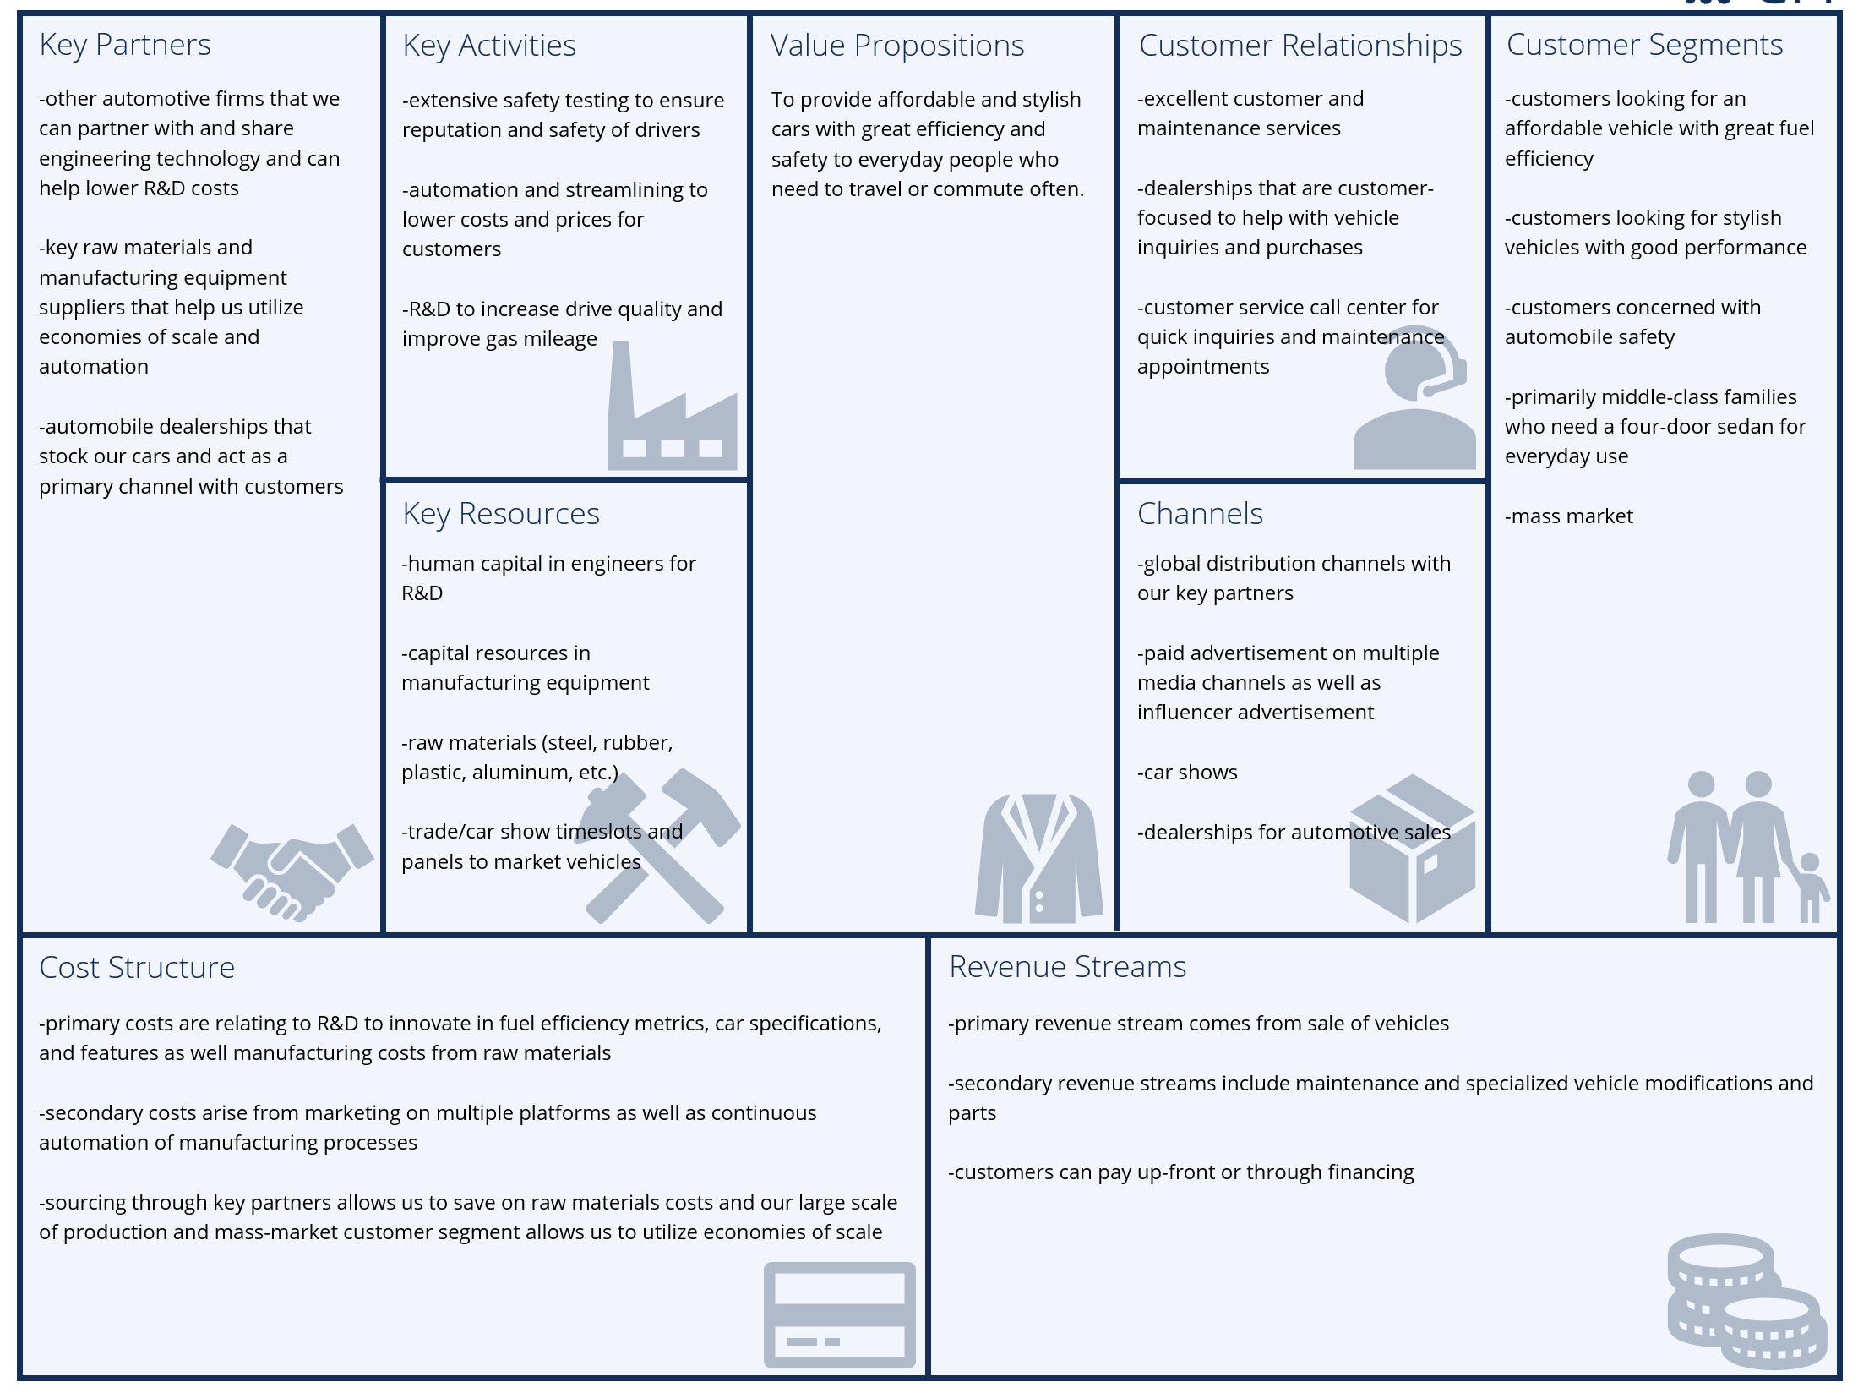
Strategies Galore
OKR
Business Model Canvas
Balanced
Score
Card
OGSM
Business
Motivation
Model
Disclaimer: No duckies were hurt in the making of this slide deck.

Slide 4
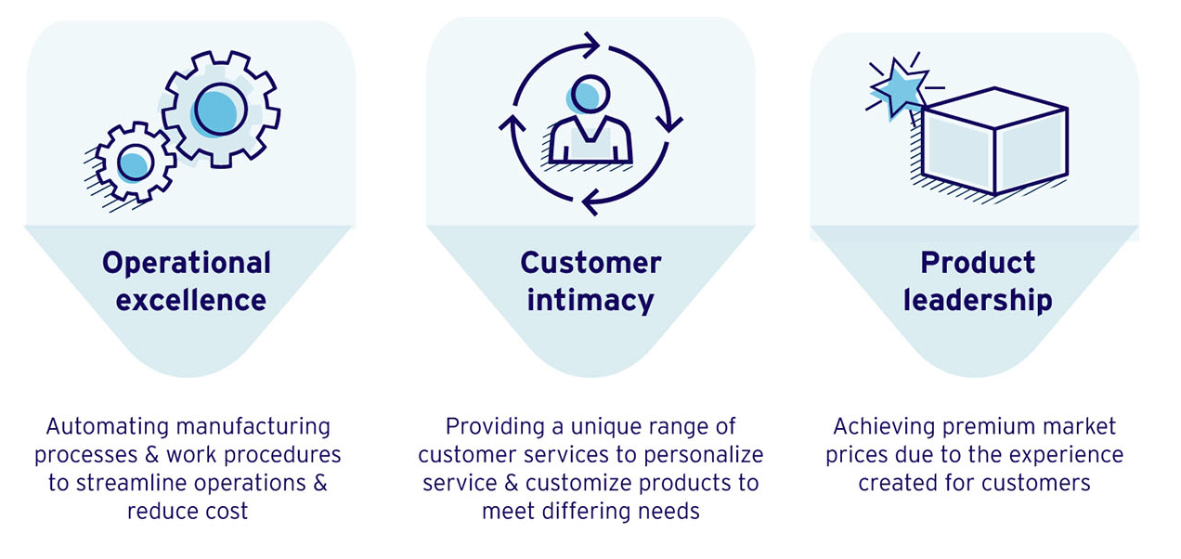
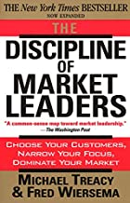
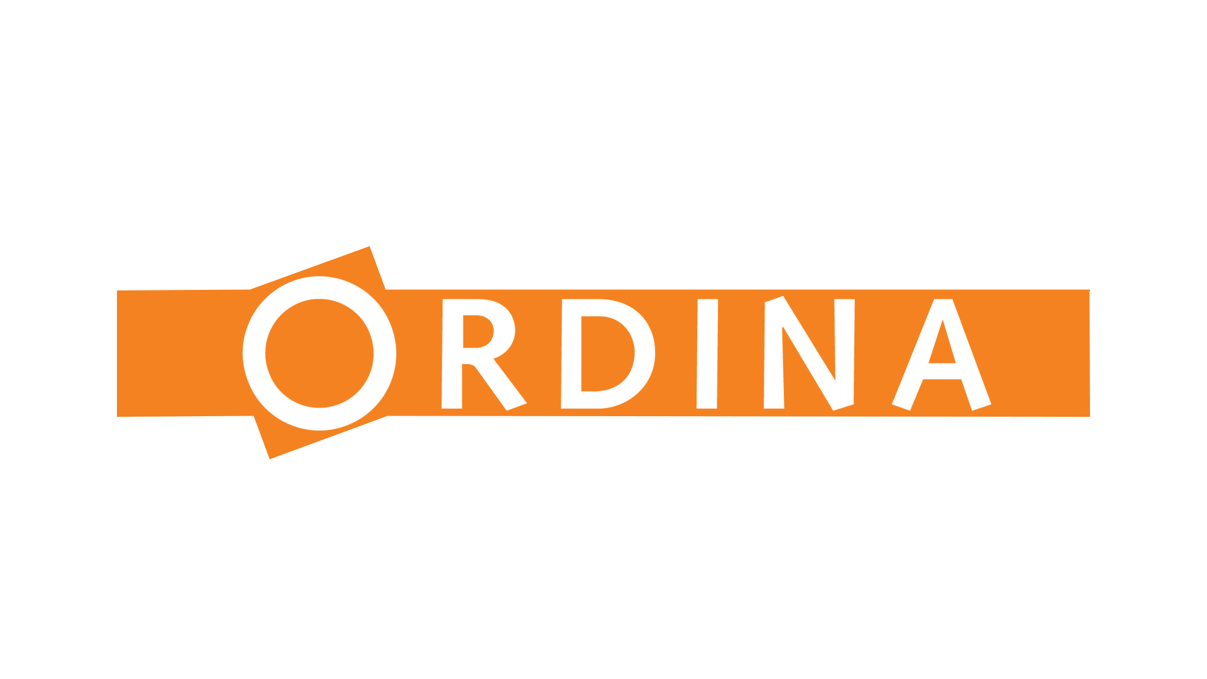
The Essence of Strategy
Option A
Option B
Option C
Option D

Slide 5
Introducing 3D Incorporated…
Our Mission
To provide the world with rubber duckies that are affordable, visually pleasing and beneficial to the environment.
Market Leader
Design Potential
We dominate the Asian and Micronesian Market, where plastic poultry is the norm.
We employ the best amongst graphical design talent to fabricate cutting edge duckie designs and train young potentials to carry the torch in years to come
Expansion Areas
Production Value
We have secured a foothold in the European Market and are actively growing our business over there.
Self-replicating duckies are no longer a dream of the future, but a modern mainstay of our production lines.
Revenue
Environmental Concerns
Profitability is assured as people will always need more rubber duckies.
All our duckies enjoy a free-range lifestyle before being placed in a loving home.
* 3D stands for DUCKS DUCKS DUCKS

Slide 6
Porter Value Chain
Inbound
Logistics
Production
Distribution
Marketing & Sales
Customer
Service
Legend
REST Service
HTTP call (Sync)

Slide 7
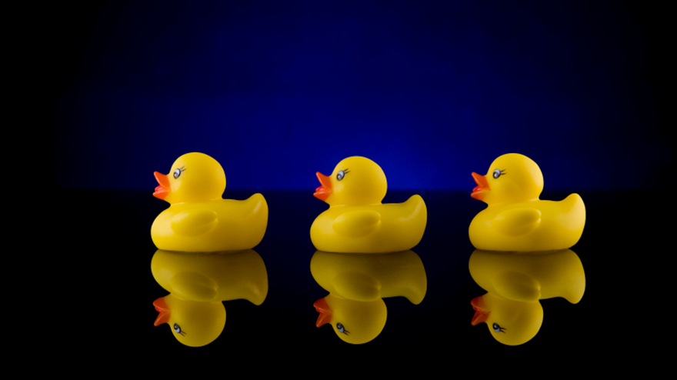
Operational Excellence
Legend
REST Service
COTS implementation
HTTP call (Sync)
Outsourced

Slide 8
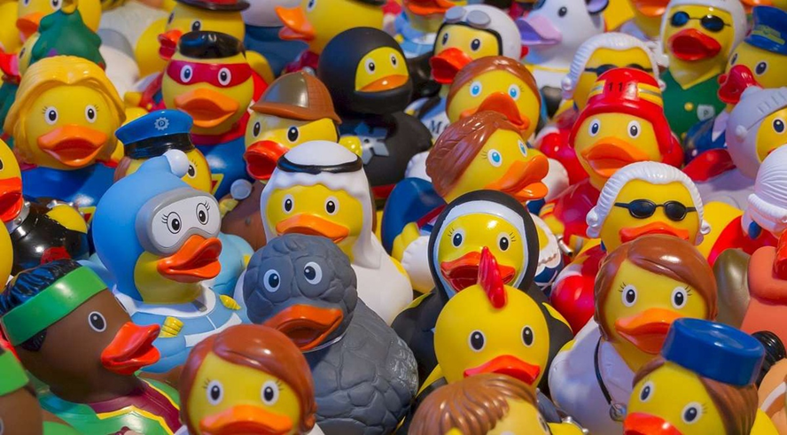
Customer Intimacy
Legend
REST Service
Router
HTTP call (Sync)

Slide 9
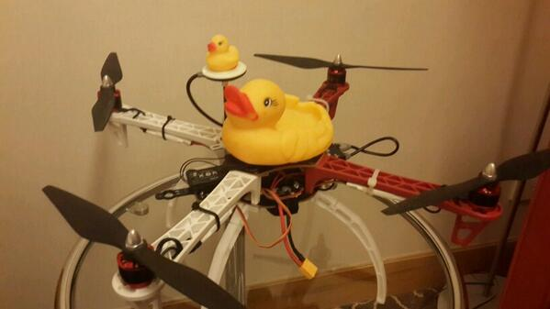
Product Leadership
v1
v2
Legend
REST Service
Load Balancer
Message Queue
HTTP call (Sync)
API Gateway

Slide 10
THANK YOU
FOR YOUR ATTENTION

