Slide 2
Technical Leadership
There are Project Managers among us

Slide 3
—Someone Famous
“This is a quote, consisting of words full of wisdom, that someone important said and will inspire the reader.”

Slide 4
Whoa!
A Project is a game of teamwork and betrayal. Team Members are either Crewmates or Impostors

Slide 5
How to Play?
Drawing up the project charter and/or project initiation document
Implementation, Quality Control,
Forecasting
Post-Mortem Retrospectives, Reporting
Conception & Initiation
Launch & Execution
Project Close
Definition & Planning
Performance
& Control
Determining scope, budget and time and formulate planning
Final Quality Control,
Final Tally

Slide 6
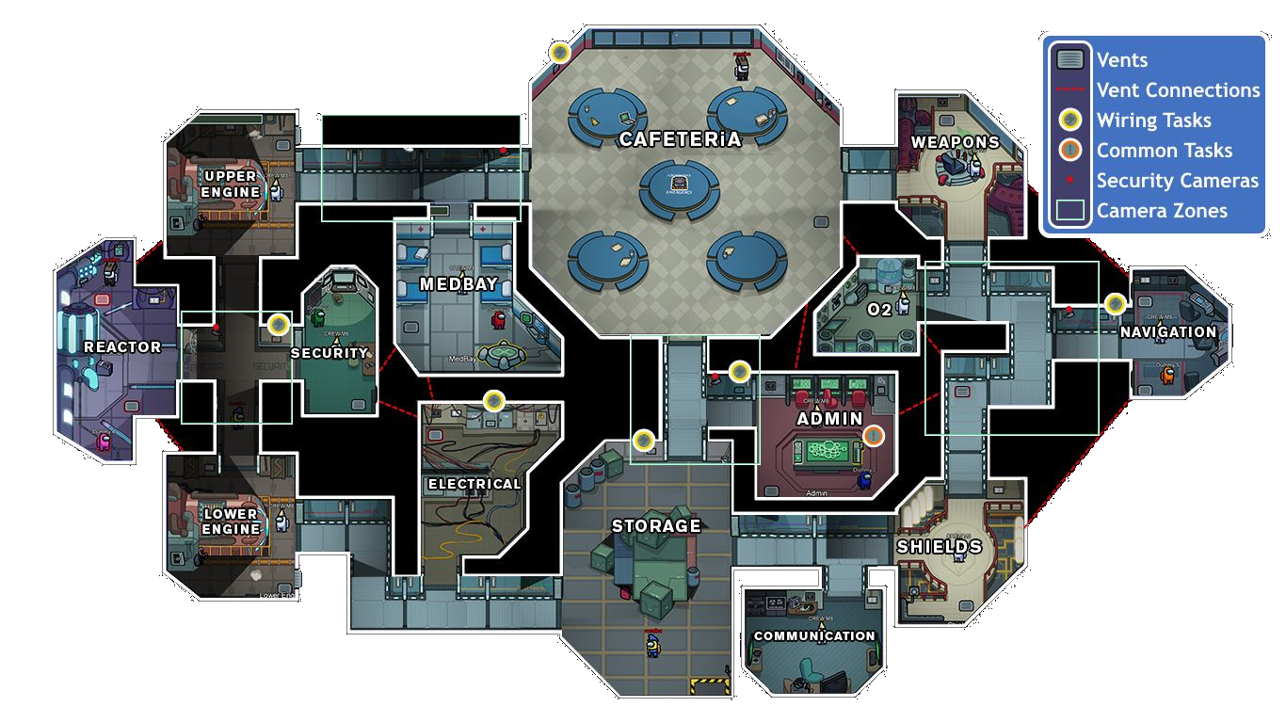
Areas of a Project
Steering Committees
Agile Rituals
Team Morale
Timeline
Continuity
Planning
Administrative Support
Compliancy
Budget Follow-up
Keeping the Lights On
Communication Plan
Project Scope
Backlog

Slide 7
The PM Tasks Guide
Management Topics | Joined Task
Cost | Provide estimates, compose team
Time | Provide insights on dependencies (both within and outside)
Scope | Offer suggestions and/or alternatives
Risk | Elaborate on technical risks and their impacts
Human Resources | Assist and inform about team (expectation management)
Stakeholders | Provide information/insights (expectation management)
Procurement | Facilitate team interactions and dependencies
Communication | Provide information/insights (inhouse marketing)
Quality | Provide information/insights (steerco preparation)
Integration | Provide information/insights for corporate processes
PMBOK ®

Slide 8
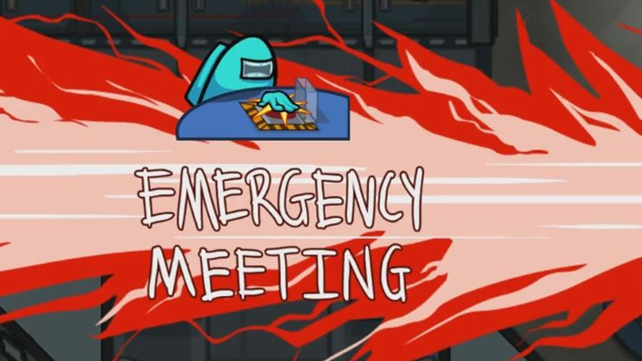

Slide 9
Team composition
Progress
Team Performance
Blocking Issues

Slide 10
Blocking Issues
Man Overboard
Velocity Issues
Estimates Revisitation
Infrastructural Issues
Administrative Overhead
Known Unknowns…

Slide 11
Blue was Ejected Man Overboard

Slide 12
Velocity Issues

Slide 13
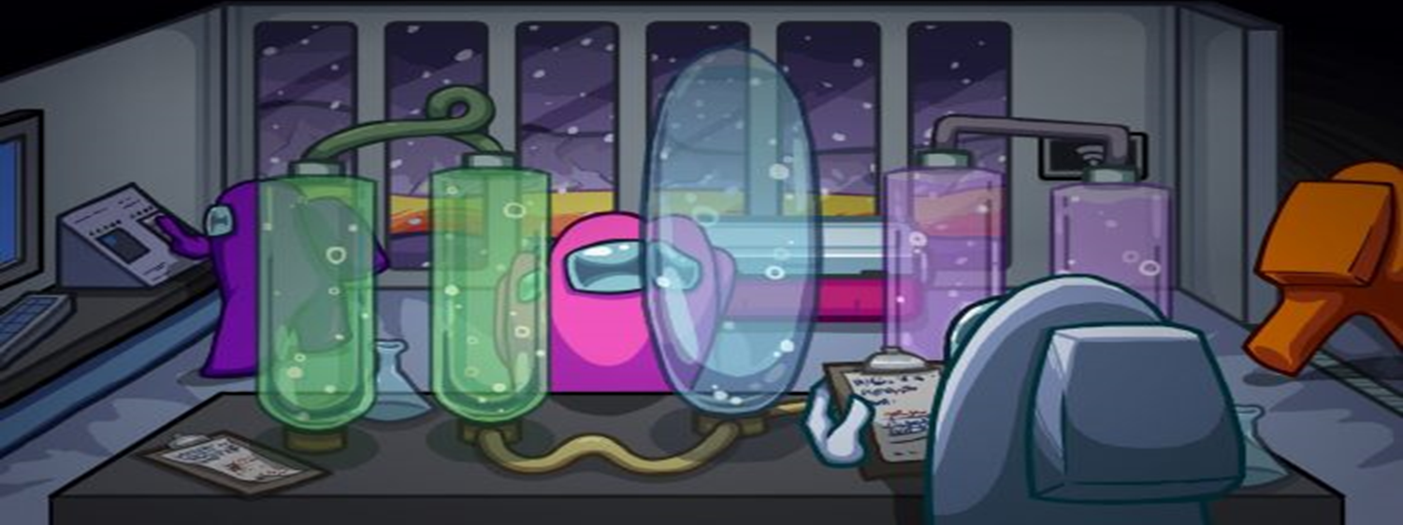
Estimates Revisitation

Slide 14
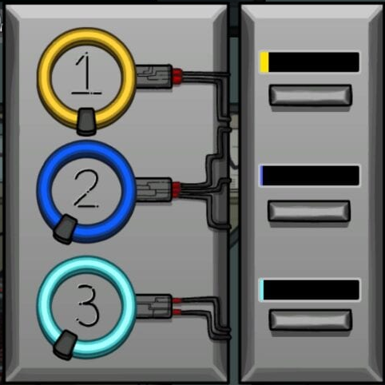
Infrastructural Issues
Environments & components
Resources from other teams
Team Equipment

Slide 15
Administrative Overhead

Slide 17
DLC
API
Economy
Next
Disruption?
DevOps
Agile

Slide 18
Thanks!
Do you have any questions?
Peter De Kinder
Solution Architect
peter.dekinder@ordina.be

